Slide 1
Snakebite Identification & Detection With Snakebite Mark Using Machine Learning Approach
Department of CSE
Jyothi Engineering College
Thrissur
17-01-2021

Slide 2
GROUP NUMBER : 23
GUIDE NAME : Dr Aswathy S U
GROUP MEMBERS : Saranya K (JEC17CS090)
Mary Jose (JEC17CS064)
Sijin K (JEC17CS096)
Yashif V S (JEC17CS106)
NAME OF THE PROJECT : Snakebite Identification & Detection With
Snakebite Mark Using Machine Learning Approach
PROJECT REPOSITORY : https://github.com/MARY2726/group-no-23-main-project
17-01-2021

Slide 3
Vision of the Department
•Creating eminent and ethical leaders in the domain of Computational Sciences through quality professional education with a focus on holistic learning and excellence.
Mission of the Department
•To create technically competent and ethically conscious graduates in the field of Computer Science and Engineering by encouraging holistic learning and excellence.
•To prepare students for careers in Industry, Academia and the Government.
•To instill Entrepreneurial Orientation and research motivation among the students of the department.
•To emerge as a leader in education in the region by encouraging teaching, learning, industry and societal connect.
17-01-2021

Slide 4
ABSTRACT
Estimates of 81,410 – 1,37,880 deaths and 4,00,000 cases of disability globally every year
Complement current approach to snakebite envenoming
Both symptoms and bite mark are taken into consideration to speed up the process of pinpointing the species before being late
Avoids fake panicking situations
Identification of the bite mark to perform anti-venom administration
17-01-2021

Slide 5
INTRODUCTION
Snakes are one of the dangerous reptiles due to their venoms
Snakebite envenoming needs urgent attention
A great deal of damage occurs following the delay in medical services
Misidentification can lead to inadequate treatment for the victim
Currently, a syndromic approach is widely used but, this strategy has limitations
17-01-2021

Slide 6
OBJECTIVES
Speed up the process of pinpointing the species before being late
To collect snake bite cases and identify the clinical effects of snake bites
Comparing with symptoms which enables early identification of snake
Immediate medication can be administered
17-01-2021

Slide 7
MOTIVATION
“Identification and recognition of distinct snake bite at the earliest, resulting in antivenom administration, which in turn narrows the mortality rate due to the envenomation”
17-01-2021

Slide 8
EXISTING SYSTEM
An Image Processing System for Identification snake bite that helps identify and classify snakes
Local Binary Pattern (LBP) for feature extraction and uses the Support Vector Machine classification method
It demonstrates the use of taxonomic features in the classification of snakes with the nearest neighbour classification
While the system only classifies venomous and non-venomous snakes without knowing the type of snake
Symptoms of an individual is not considered
17-01-2021

Slide 9
EXISTING SYSTEM
Drawbacks
Wrinkled or hairy skin or bruising on the bite or wound area affect calculated result.
Blood clots on the bite marks causes classification errors because system incorrectly detect snake bite, which should not snake bite resulting in a poor accuracy
This system only determine whether the snake is venomous or not couldn’t identify the snake
17-01-2021

Slide 10
LITERATURE SURVEY-1
Detection of Knee Osteoarthritis Using X-Ray
Features
This system detect osteoarthritis (OA) from knee X-ray images using image processing technique.
Using this approach better diagnosis treatment can be applied to the patient since a computed automated measurements leads to accurate values.
Using Kellgren Lawrence scale severity of osteoarthritis can measure easily.
17-01-2021

Slide 11
LITERATURE SURVEY-1
ADVANTAGE
Predict KL-Scale grade automatically.
Reduce radiologist work and burden.
Diagnosis make easier.
DISADVANTAGE
Patient age and region affect the accuracy of result.
Precision of result depants on quality of X-Ray.
Lack of sufficient data data set affect the KL-Grading
17-01-2021

Slide 12
LITERATURE SURVEY-2
A Development of Snake Bite Identification System (N'viteR) using NEURO-GA
Differentiate between venomous and non-venomous snake
This hybrid technique has achieved 97.6% of accuracy
Enables early identification of snake
Immediate medication can be administered
17-01-2021

Slide 13
LITERATURE SURVEY-2
A Development of Snake Bite Identification System (N'viteR) using NEURO-GA
ADVANTAGES :
Based on the experiments it shows that epoch 4000 give a high accuracy
Even better than BPNN, this is a combination with GA yields a high accuracy to identify a venomous and non-venomous snake based on cases provided
DISADVANTAGES :
This technique may give higher accuracy but it will take a longer time to finish the training process
Data will not determine any specific feature other than info about venom
17-01-2021

Slide 14
LITERATURE SURVEY-3
An efficient Harris hawks-inspired image segmentation method
The multilevel thresholding method is more efficient for segmenting digital mammograms.
An efficient methodology for multilevel segmentation is proposed using the Harris Hawks Optimization (HHO) algorithm and the minimum cross- entropy as a fitness function.
Efficient tool that can be used as a preprocessing step in different image processing systems is called MCET-HHO.
Proposed method optimizes the search for the best solution of a function inspired by the behavior of the Harris hawks.
17-01-2021

Slide 15
LITERATURE SURVEY-3
An efficient Harris hawks-inspired image segmentation method
Advantage:
More efficient for segmentation method.
This algorithm presents robustness in its behavior.
Produces efficient and reliable results in terms of quality, consistency, and accuracy
Disadvantage:
It has shown a potential in jumping of local optimum solution.
It is not able to handle RGB images.
17-01-2021

Slide 16
LITERATURE SURVEY-4
Deep Learning Model for Identifying Snakes by using Snakes’ Bite Marks
Identifying snakes by using their bite marks
They are classifying them as venomous and nonvenomous using CNN.
Advantage:
To identify which species of snake.
Can start fast treatment.
Idea may help the public to stop about afraid of snakes bites.
Disadvantage:
When a new pattern is identified then the system should updated.
17-01-2021

Slide 17
DESCRIPTION OF THE PROPOSED SYSTEM
The system is to identify the snakebite from the bite image and the symptoms that are experienced by the person that can helps to get faster medical aid
Speeds up the process of pinpointing the species before being late
Concepts of Machine Learning and Image Processing for the identification and classification of snakebites
Doctors also can use our system to identify the snake and start administering medication
17-01-2021

Slide 18
FEATURES OF PROPOSED SYSTEM
The system provide necessary information regarding the snake using the snake bitten mark
Identifying snakes by using bite mark helps the doctor to diagnose the victim with proper anti venom
Helps to decrease the snakebite envenoming deaths to a certain length
17-01-2021

Slide 19
SRS
Functional Requirements
User can be anyone like Doctor, medical experts etc.
User can directly scan the snake bitten area.
User can easily identify which snake has bitten.
Appropriate medication can be taken.
Nonfunctional Requirements
Performance Requirements
The application should provide correct output. It will correctly detect the snake. The performance will be good. The usage and understandability will be easy. The app will mostly give the true answer.
Safety Requirements
This provides a confidential data from the database, gives about the bit mark. Doctor can take the safety measurement and apply the medicine.
Security Requirements -The database should be secure. No crash or damage can be occur to the database.
Software Quality Attributes
Correctness - They will process the image and gives correct snake bite.
Availability- The app will be available in app store.
Adaptability- The application can be used in any android version platform.

Slide 20
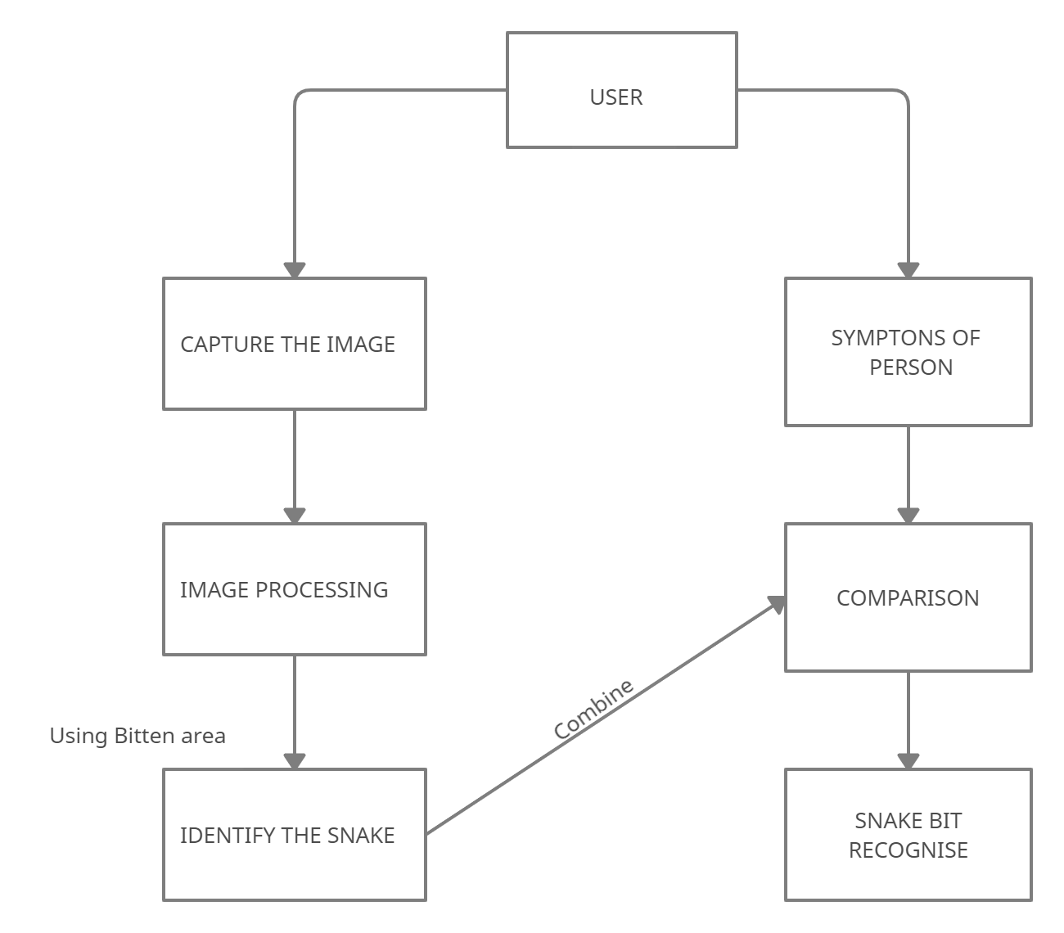
STRUCTURE CHART
17-01-2021

Slide 21
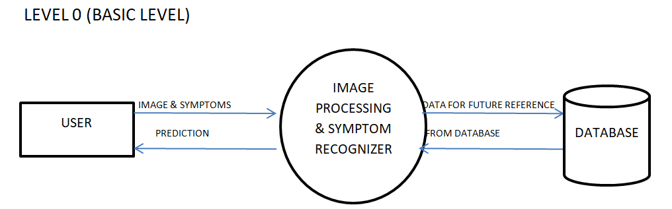
DFD & UML DIAGRAMS
17-01-2021

Slide 22
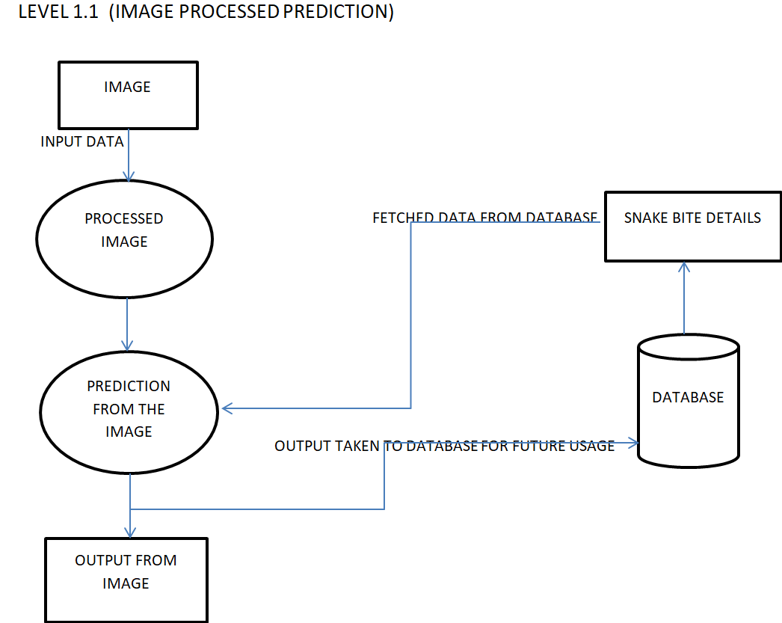
17-01-2021

Slide 23
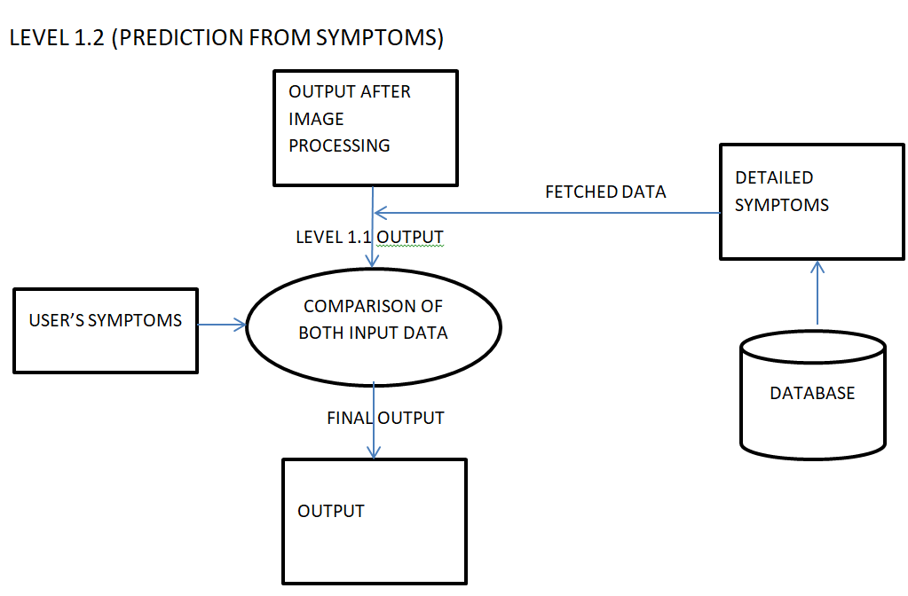
17-01-2021

Slide 24
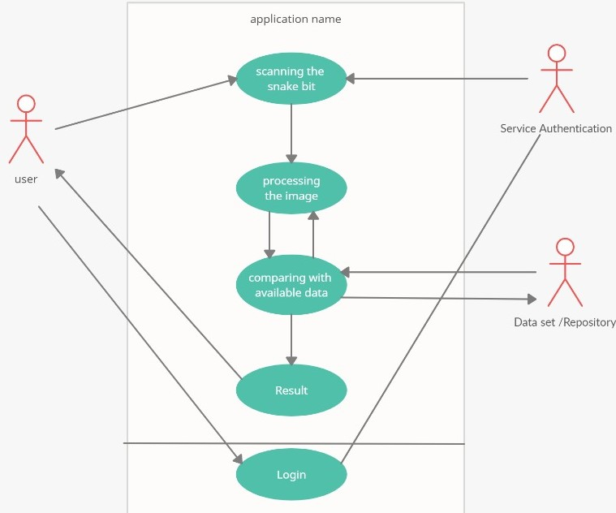
17-01-2021

Slide 25
APPLICATIONS
Medical Field
Can be used in future for antivenom administration
17-01-2021

Slide 26
COURSE OUTCOMES
C410.1 The students will be able to analyse a current topic of professional
interest and present it before an audience.
C410.2 Students will be able to identify an engineering problem, analyse it and
propose a work plan to solve it.
C410.3 Students will have gained thorough knowledge in design,
implementations and execution of Computer science related projects.
C410.4 Students will have attained the practical knowledge of what they learned
in theory subjects.
C410.5 Students will become familiar with usage of modern tools.
C410.6 Students will have ability to plan and work in a team.
17-01-2021

Slide 27
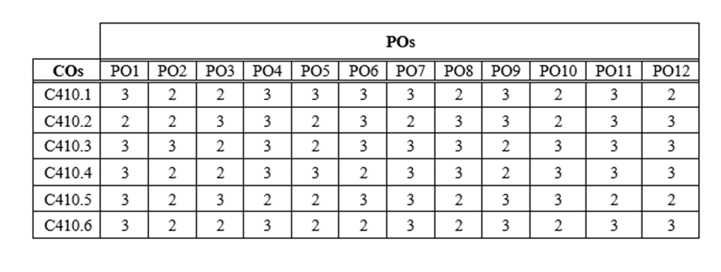
COURSE OUTCOMES
17-01-2021

Slide 28
PENDING TASKS
The dataset for the model is to be populated
The model is implemented and coded
The model is to be trained using the training data
The model is to be tested for accuracy

Slide 29
CONCLUSION
It is possible to identify which snake has been bitten and give the appropriate treatment
This app can bring new benefits in the field of health
Mortality rate due to envenoming can be decreased
Implementation of this system avoids future medical negligence
More cost effective.
High accuracy
Cross checking can help in pinpointing the species
17-01-2021

Slide 30
REFERENCES
https://ieeexplore.ieee.org/document/6291349
https://ieeexplore.ieee.org/document/9104200
Image processing for snake identification based on bite using local binary pattern and support vector machine method-Yoga Widi Pamungkas, Adiwijaya Adiwijaya,Dody Qori Utama
https://www.google.com/url?sa=t&source=web&rct=j&url=http://ijcsit.com/docs/aceit-conference-2016/aceit201618.pdf&ved=2ahUKEwiA-_S7gqXuAhXDR30KHWHXBjEQFjAAegQIARAB&usg=AOvVaw3KGeALO15FLSQkVPajYB5K

Slide 31


